Slide 1

Free to Help
Notes:
Catherine

Slide 2
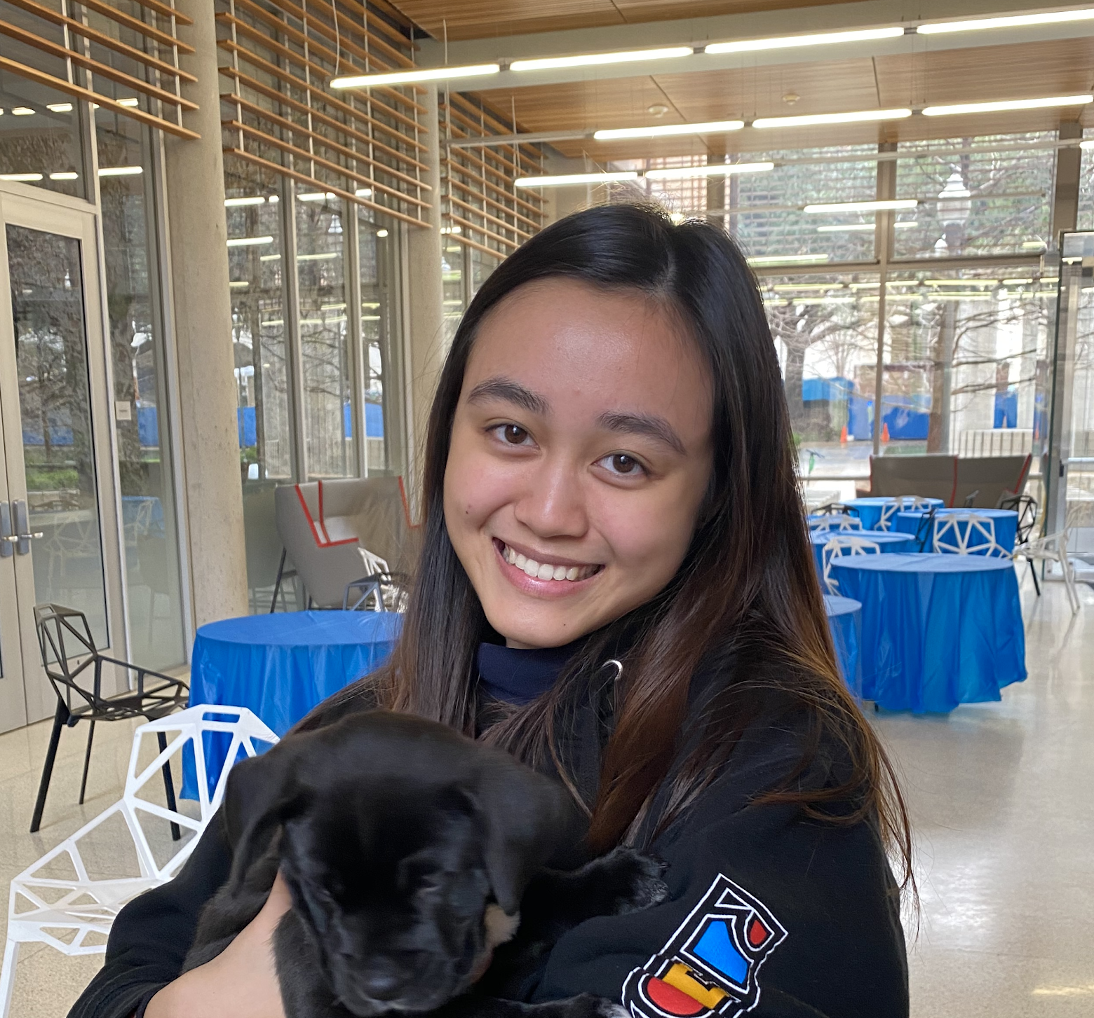
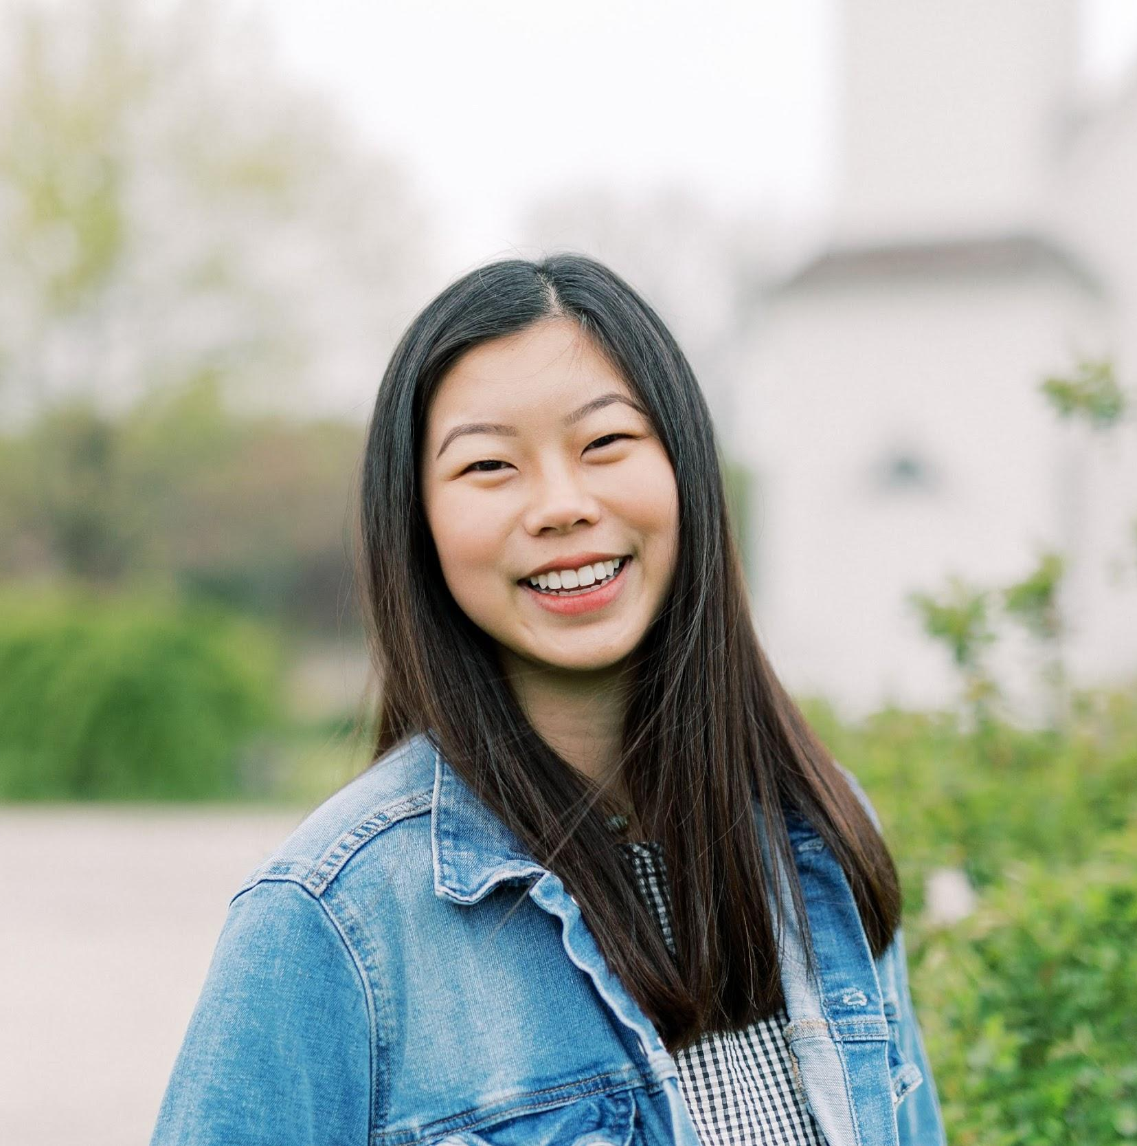
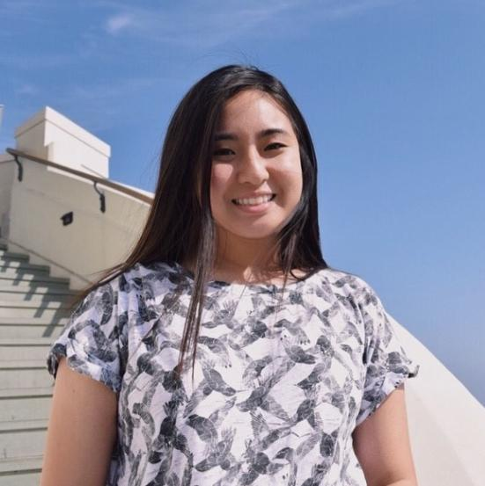
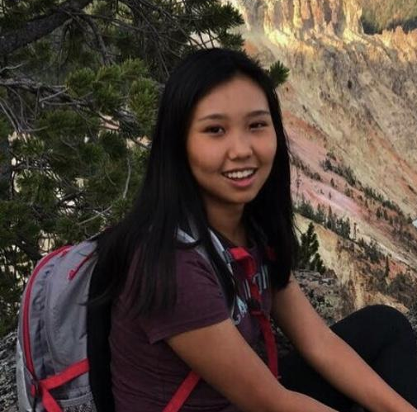
Kelly Chiu Irena Lee Catherine Fang Grace Wang
Freshman, B.S. Computer Science
Freshman, B.S. Computer Science
Freshman, B.S. Computer Science
High School Senior
The Team

Slide 3


Theme
Promoting greater involvement in the community.
THEME SOLUTION IMPLEMENTATION PROCESS DEMO CONCLUSION
Notes:
Catherine

Slide 4
Effectiveness of Idea
According to the US Bureau of Labor Statistics, only 25% of Americans take time to volunteer. However, research has shown that over 90% of us want to volunteer.
The Stanford Center on Longevity states that the most common reason for not volunteering is lack of free time.
THEME SOLUTION IMPLEMENTATION PROCESS DEMO CONCLUSION
Notes:
Ever wanted to volunteer, only to struggle when finding an event that fits your schedule?

Slide 5
Solution
Free to Help creates a platform where users may access a database of volunteer opportunities according to their taste and availability.
THEME SOLUTION IMPLEMENTATION PROCESS DEMO CONCLUSION
Notes:
Catherine

Slide 6
Implementation
Google Chrome Extension (HTML, JavaScript, CSS)
Beautiful Soup (Python)
Prototype App
THEME SOLUTION IMPLEMENTATION PROCESS DEMO CONCLUSION
Notes:
Kelly - Beautiful Soup to web scrape for dynamic data

Slide 7
The Process
Suggests available volunteer opportunities for a personalized calendar.
Tracking hours and submissions between schools, students, and organizations.
THEME SOLUTION IMPLEMENTATION PROCESS DEMO CONCLUSION
Notes:
Irena

Slide 8
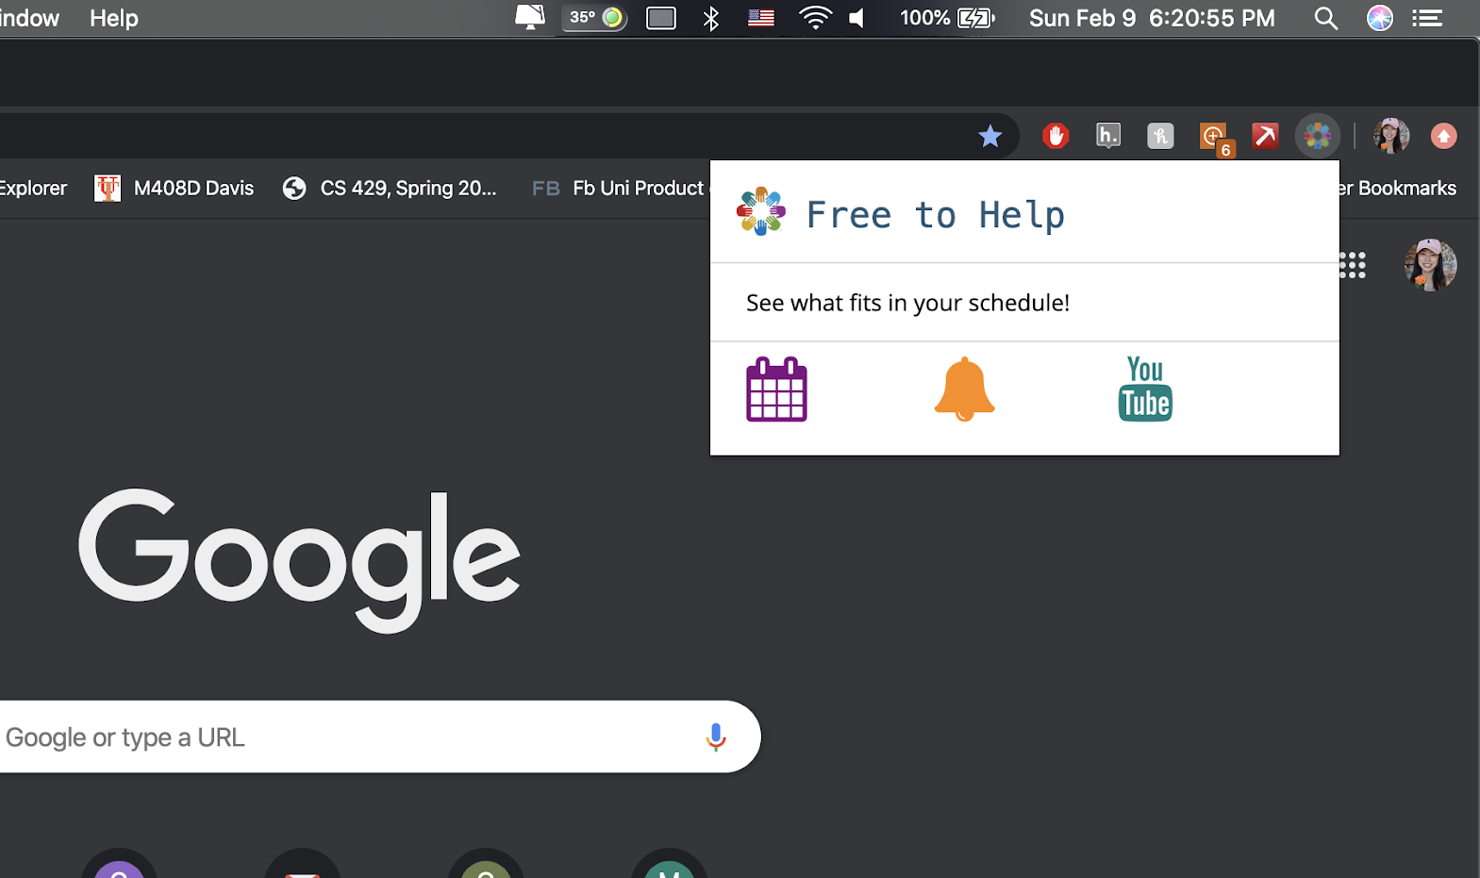
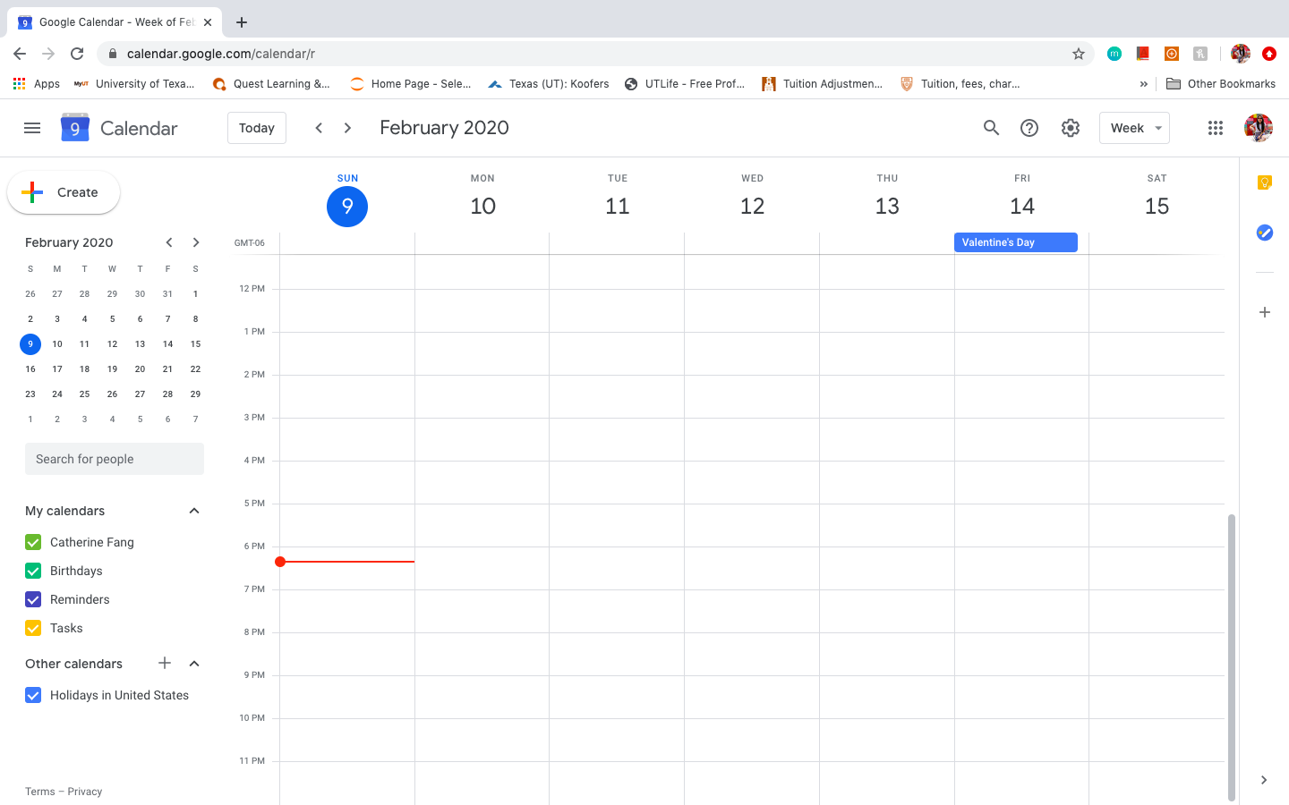
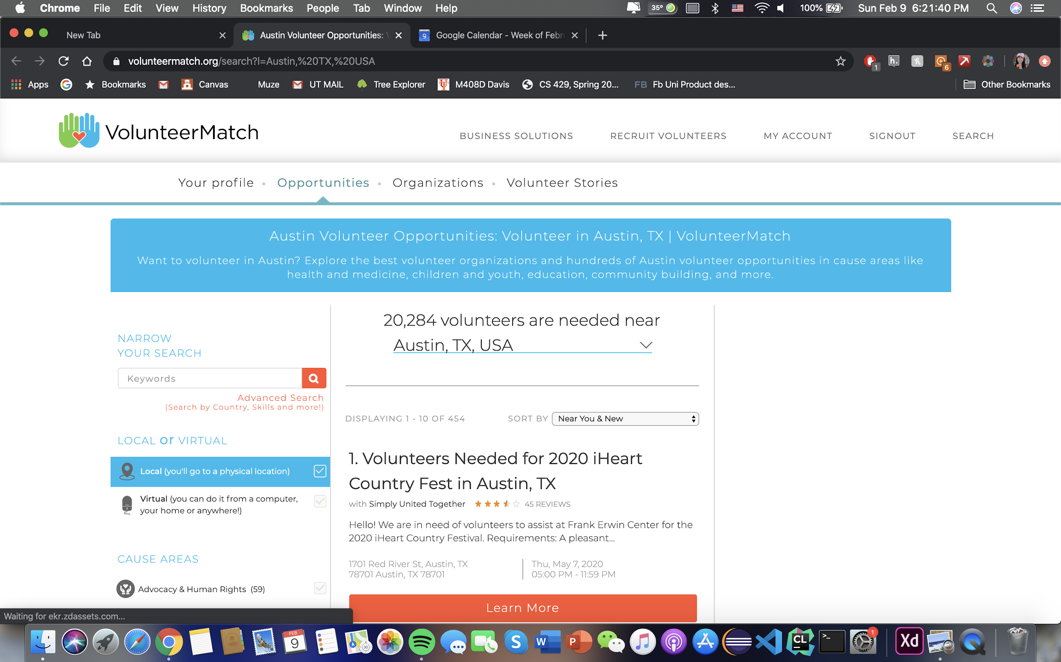
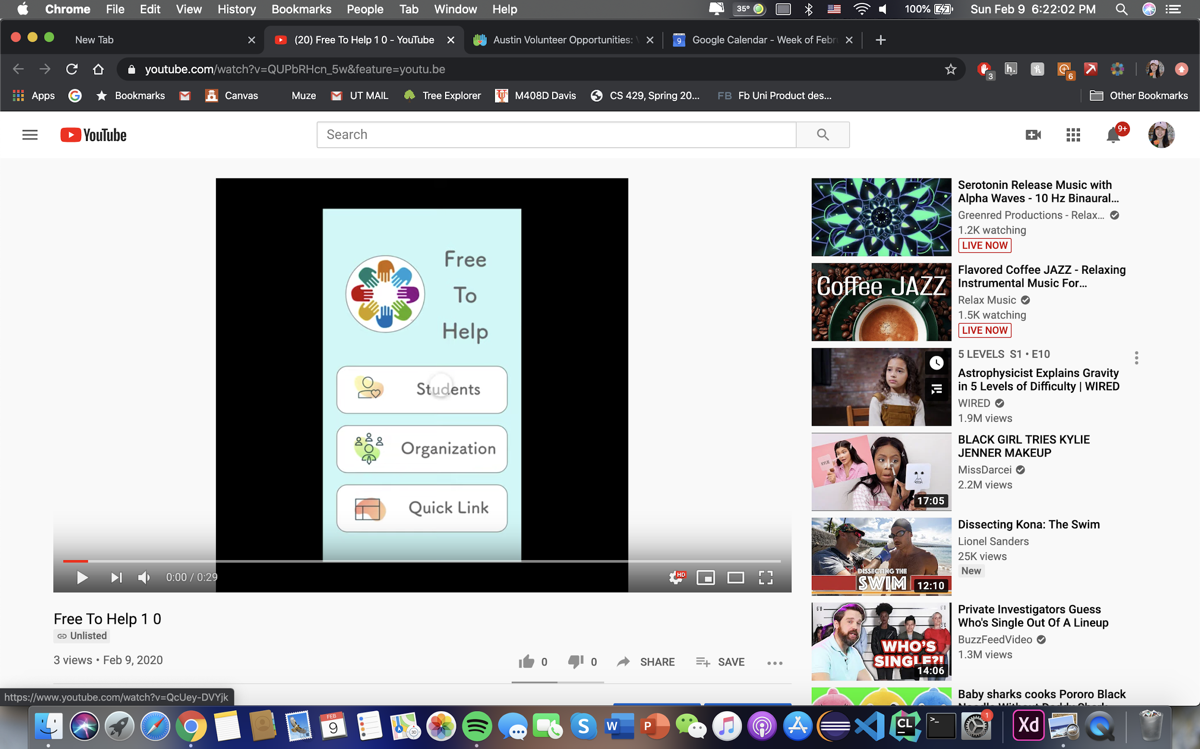
Demo
THEME SOLUTION IMPLEMENTATION PROCESS DEMO CONCLUSION
Notes:
Irena

Slide 9
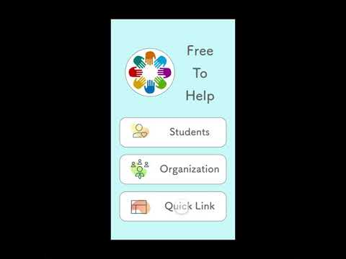
Demo
THEME SOLUTION IMPLEMENTATION PROCESS DEMO CONCLUSION
Notes:
Irena

Slide 10
Social Impact
Equipping students with the tools to contribute their time for a greater cause.
THEME SOLUTION IMPLEMENTATION PROCESS DEMO CONCLUSION
Notes:
Kelly

Slide 11
Thank you for your time!

